Slide 1
Suggested transition lesson “Raúl y las alas mágicas”
Y7 to visit a primary school and work in a carousel of activities. The lesson is planned for pupils to work 8 minutes at each activity but could be adapted to your needs/preferences.
La palabra extraña
(reading)
Carrera de dictados
(reading, listening and speaking)
Las descripcciones
(reading)
La crítica
(writing)
Escucha y ordena el texto
(listening and reading)
El comic
(writing)

Slide 2
Can you organise 3 transition activities with your Y6 class and a secondary school?
Start with one activity in the summer term! (This could be Raúl y las alas mágicas).
Plan a Y6 visit to secondary in September to celebrate European Day of languages on 26th September. (Pupils could have taster sessions of any language you chose!)
Have pupils teach each other! (Secondary pupils could visit a primary and teach some mini lessons, or you could bring some primary pupils to teach in secondary!)
Swap teachers! (Arrange with a colleague to teach one of their classes.
Invite secondary pupils primary Hispanic day celebrations! (They could simply join in with what you have planned or run some workshops).
6th July transition event day all subjects.

Slide 3
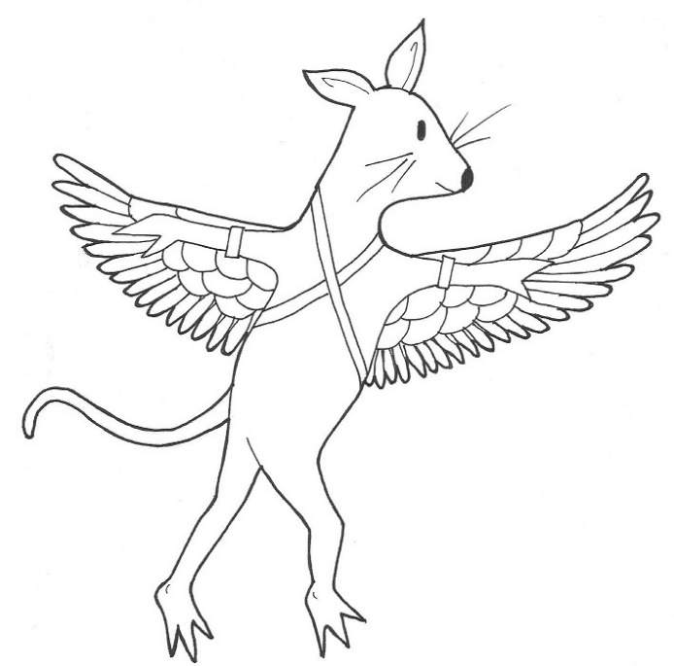
Raúl y las alas mágicas in Y7
Raúl y las alas mágicas
por
Dawn Alexander-Joseph
Aránzazu M. Pérez Perdomo
y
Joe Stewart
dibujos Colette Lambe
Would any of the activities in Unit 22 work in Y7?
Read the whole story
Use some of the pictures in the book for pupils to practice descriptions.
Choose paragraphs or a chapter for your pupils to re-write by adding more details, connectives, etc.
Re-write the story changing the characters, the stolen object/s and the location. Try to keep it in Hackney!

