Slide 1
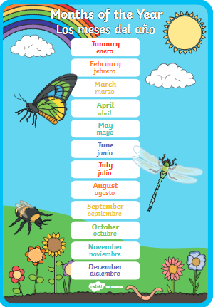
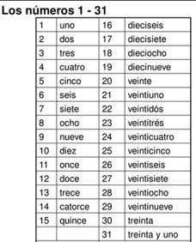
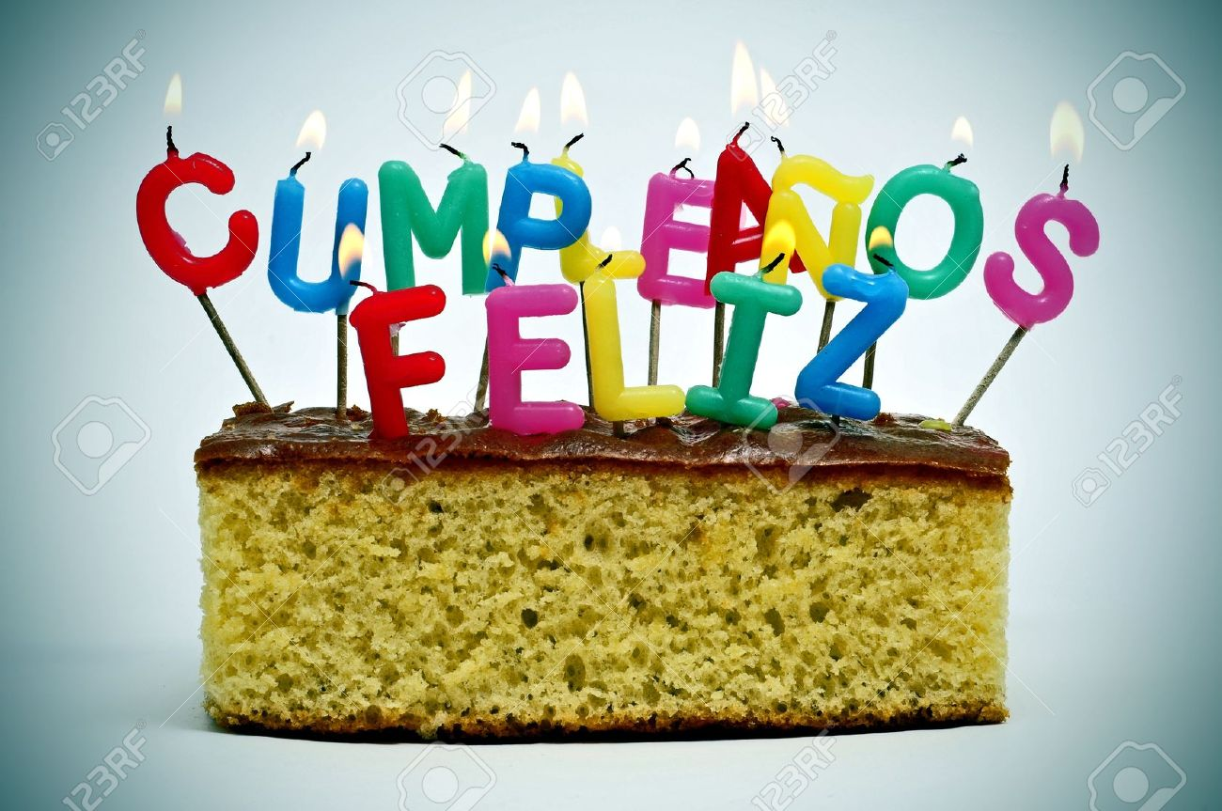
Spanish
Year 3 Unit 3
VERBS:
¿Qué haces? – what do you do/what are you doing?
Cantar – canto – I sing/am singing
Tocar – *toco (a musical instrument only) –
I play/am playing
Bailar – bailo – I dance/am dancing
Nadar – nado – I swim/am swimming
Saltar – salto – I jump/am jumping
Hablar – hablo – I speak/am speaking
Escuchar – escucho – I listen to/am listening to
Mirar – miro – I look at or watch/am looking at or watching
Caminar – **camino – I walk/am walking
*toco is only used for musical instruments and also means ‘I touch/am touching.’
**camino is ‘I walk/am walking’, but not in the sense of ‘I go for a walk/am going for a walk’, which is a different verb in Spanish.
¿Cuándo es tu cumpleaños?
- When is your birthday?
Mi cumpleaños es el 2 de mayo
- My birthday is on the 2nd of May.

