Slide 1
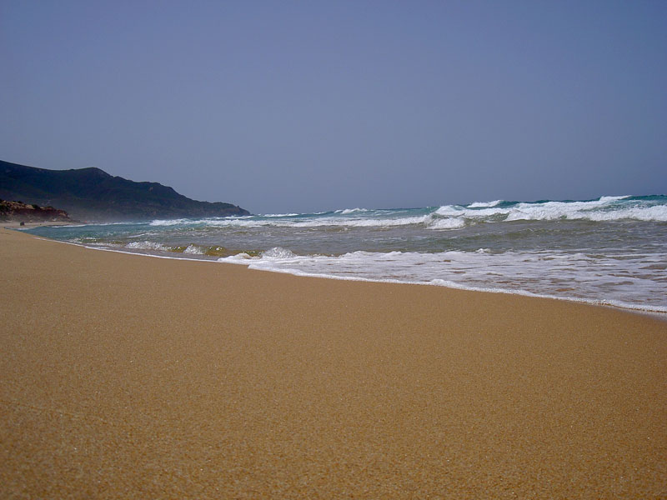
En la Playa

Slide 2
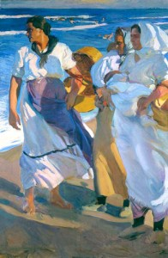
Joaquin Sorolla:
Pescadoras Valencianas

Slide 3
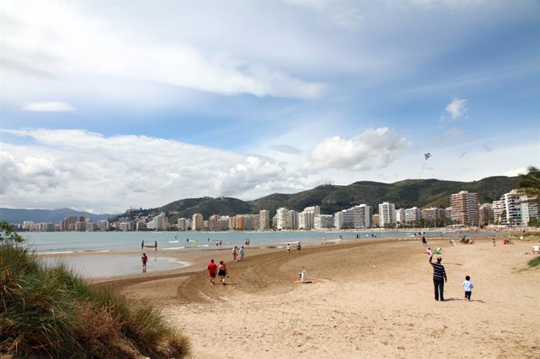
La Playa de Valencia

Slide 4
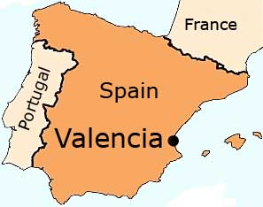

Slide 5
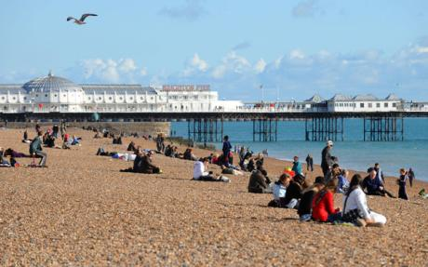
La Playa de Brighton

Slide 6
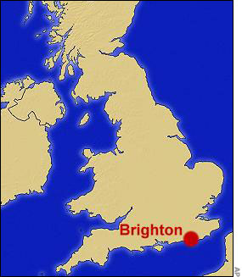

Slide 7
Valencia
Brighton

Slide 8
On next slide onwards, pupils see new vocabulary in Spanish.
Click the sound icon to hear pronunciation.
Ask for the meaning in English, doing an action if necessary, then click action button twice, (1) to see picture and then (2) to see translation.

Slide 9
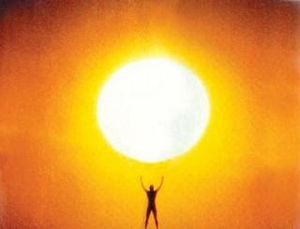
un sol brillante
a shining sun

Slide 10
la arena amarilla
*It is really ‘the yellow sand’, but is ‘some yellow sand’ in the English translation of the full Spanish poem in lesson 6.
some yellow sand*

Slide 11
un barco pequeño y rojo
a little red boat

Slide 12
la niña que duerme
the little girl who is sleeping

Slide 13
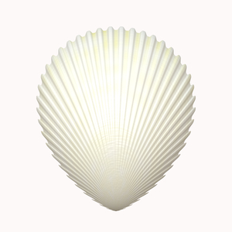
una concha blanca
a white shell

