Slide 1

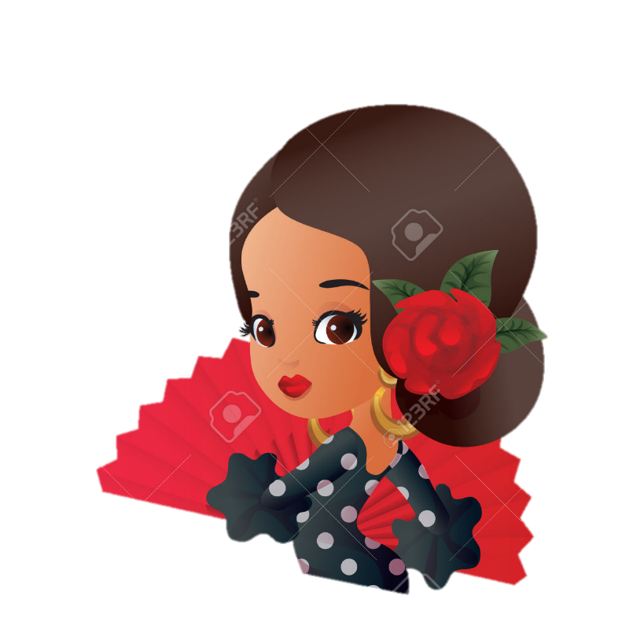

¿Tocas un instrumento musical?

Slide 2
1 On next slide click the gold sound icon to hear the as yet unknown instrument’s sound.
2 Pupils say the instrument they hear in Spanish with the support of word cards on the board.
3 Click the action button to reveal the instrument picture.
4 Click the grey sound icon to hear ‘Toco + instrument’ in Spanish.
5 Click the action button to see the sentence, and pupils repeat.

Slide 3

Toco el violín

Slide 4

Toco el piano

Slide 5
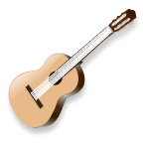

Toco la guitarra

Slide 6
Toco la batería

Slide 7
Toco el saxofón

Slide 8
Toco el clarinete

Slide 9

Toco la trompeta

Slide 10
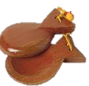
Toco las castañuelas

Slide 11
1 On next slide click action button and ¿Qué falta? appears (What is missing?).
2 Pupils say the instrument that is missing in Spanish with the support of word cards on board.
3 When you click the action button again, the picture reappears.

Slide 12
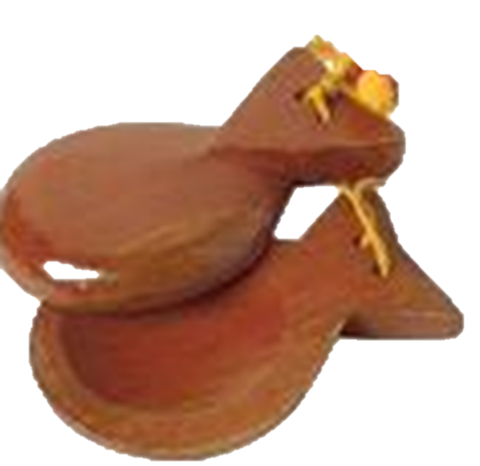


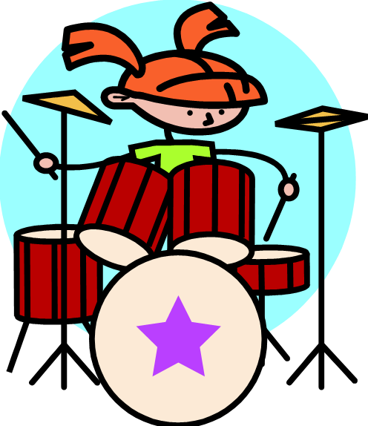


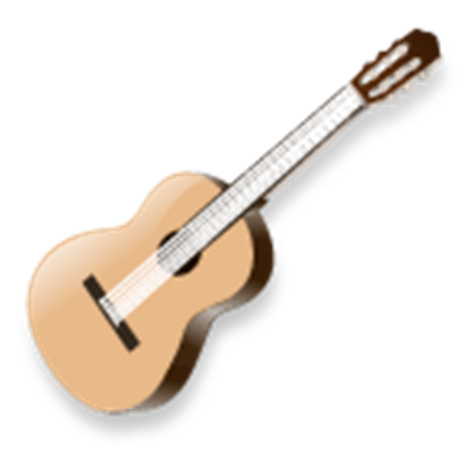


Slide 13
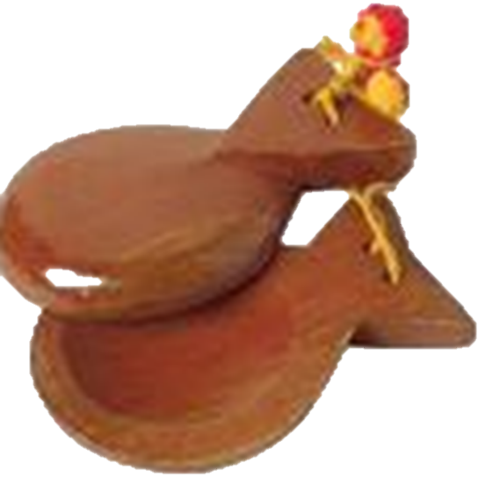


Slide 17



Slide 18
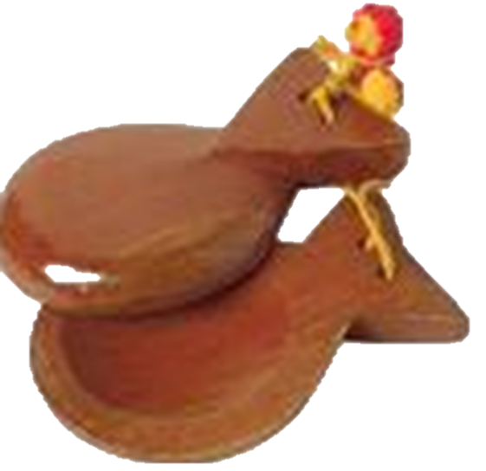

Slide 20


