Slide 1
Spanish Sounds 3

Slide 2
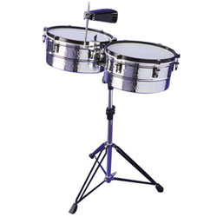
Accents
The accent (/) helps you to pronounce the word.
The accent does not change the vowel sound. It tells you which syllable to pronounce with emphasis.
marrón
batería

Slide 3
Stress
Words that end in a consonant other than n or s should be stressed or said the loudest, on the last syllable.
doctor
Words that end in a vowel, n, or s should be stressed or said the loudest, on the second to last syllable.
libro

Slide 4
Every possible pronunciation of each letter of the Spanish alphabet in ONE sentence! See clip below.

Slide 5
The sentence in Spanish and English
La cigüeña gigante bebió ocho copas de whisky, más quince jarras llenas de fría cerveza rubia, y enseguida huyó en un taxi.
The giant stork drank eight glasses of whiskey, plus fifteen full mugs of cold pale ale, and escaped in a taxi right away.

