Slide 1
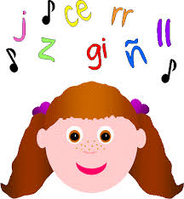
Spanish phonics

Slide 2
What is phonics?
It is linking sounds with letters of the alphabet.

Slide 3
What are phonemes?
They are the individual sounds in a word, e.g.
i
j
amigo
junio

Slide 4
Similarities between Spanish and English
Both languages use the Roman alphabet.
Many words are the same in both languages.

Slide 5
Can you work out the meanings of these Spanish cognates in English?
helicóptero
limón
fantástico
océano
televisión
elefante
noviembre
enorme
planeta

Slide 6
helicopter
lemon
fantastic
ocean
television
elephant
November
enormous
planet

Slide 7
Differences between Spanish and English
Both languages have 5 vowel letters, but there are 5 vowel sounds in Spanish and 12 in English.
There are 26 letters in the English alphabet with 44 sounds, and 27 letters in the Spanish alphabet with 30 sounds.
The extra letter in the Spanish alphabet is ‘ñ’.

Slide 8
Facts about the Spanish alphabet - 1
There are 3 other letters that used to be part of the Spanish alphabet until recent times - ch, ll and rr - and which are still included in many resources.
Although these 3 letters are no longer in the most recent versions of the Spanish alphabet, their sounds still exist.

Slide 9
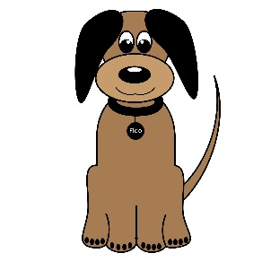
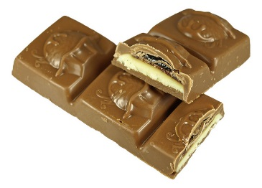
‘ch’, ‘ll’ and ‘rr’
CHocolate
peRRo
amariLLo

Slide 10
Facts about the Spanish alphabet - 2
The letters K and W do not exist in Spanish words unless the words originated in another country, e.g. koala, wok.
In Spanish you must pronounce every single letter except ‘h’.

Slide 11
¡Vamos a cantar!

Slide 12
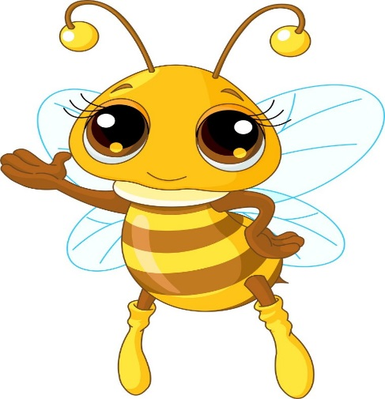
Here are words that begin with each letter of the Spanish alphabet (or have the letter within the word as in the ‘Ñ ñ’ example).
A a
abeja

Slide 13
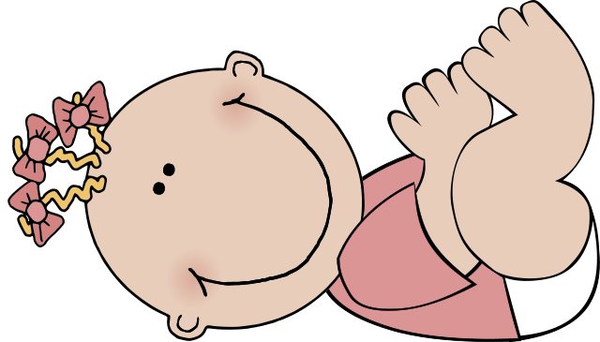
B b
bebé
the letters b and b are pronounced exactly alike in Spanish

Slide 14
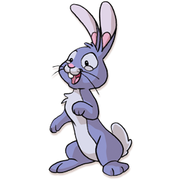
*C c
conejo
‘hard’ c before a,o,u

Slide 15
*C c
cien
‘soft’ c before e,i

Slide 16
D d
dedo

Slide 17
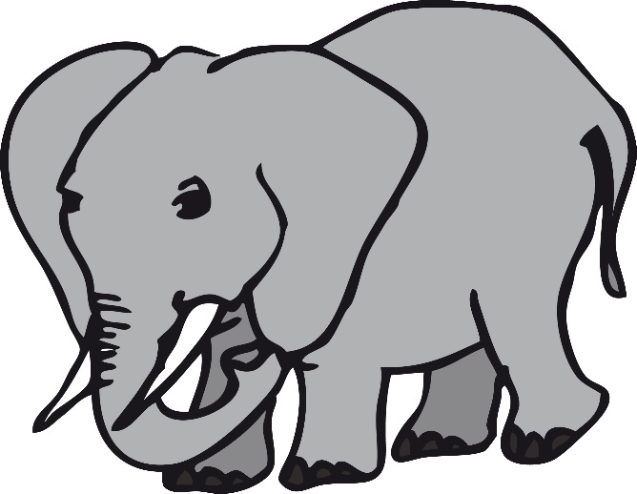
E e
elefante

Slide 18
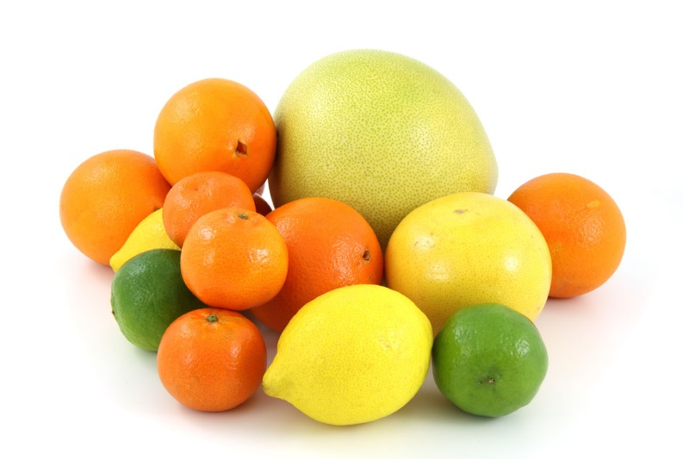
F f
fruta

Slide 19
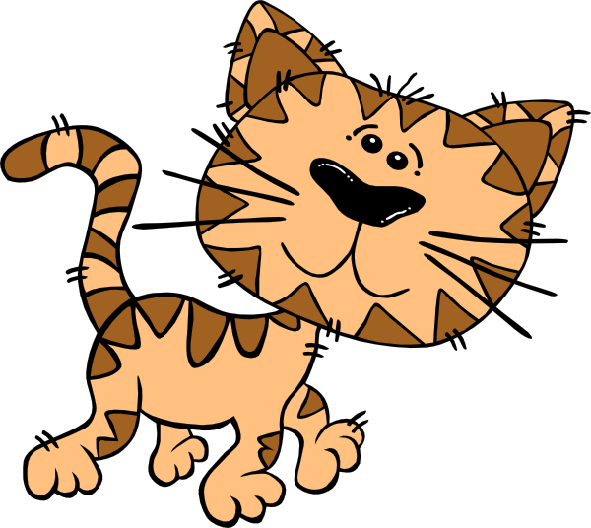
G g
gato
‘hard’ g before a,o,u

Slide 20
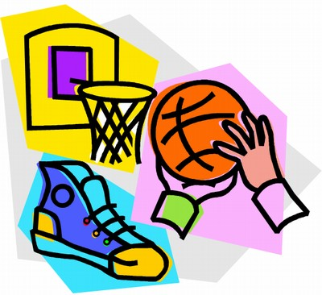
G g
gimnasio
‘soft’ g before e,i

Slide 21
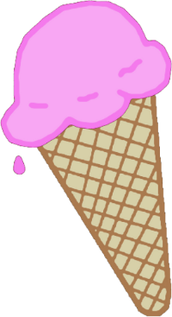
H h
helado
h is a silent letter in Spanish

Slide 22
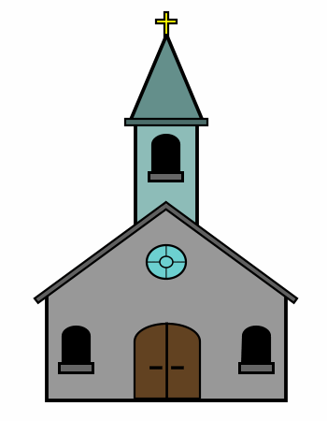
I i
iglesia

Slide 23
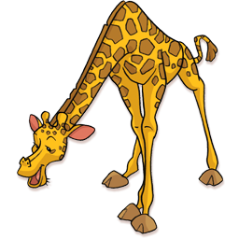
J j
jirafa
j in Spanish sounds like h in English

Slide 24
K k
kilo

Slide 25
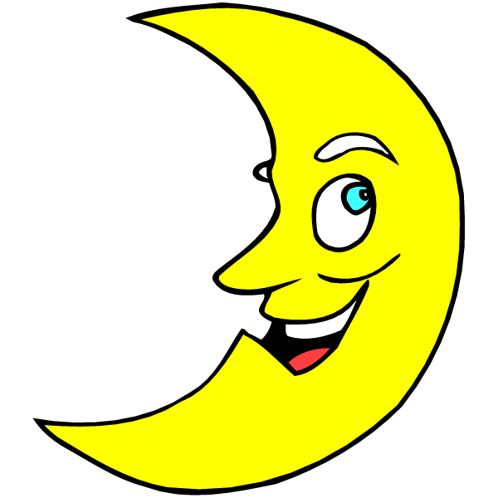
L l
luna

Slide 26
M m
mano

Slide 27
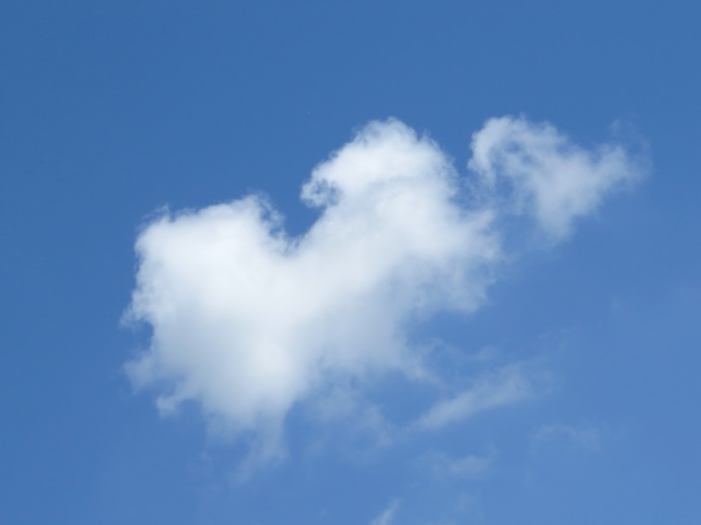
N n
nube

Slide 28
Ñ ñ
señorita
ñ is like ‘ny’ sound in English

Slide 29
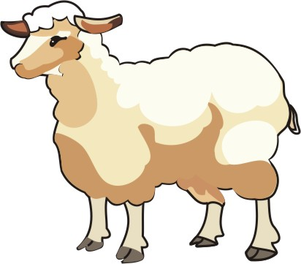
O o
oveja

Slide 30
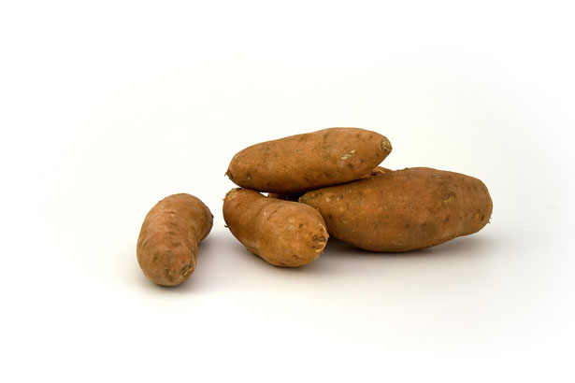
P p
patatas

Slide 31
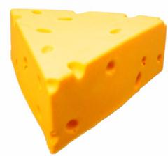
Q q
queso
‘qu’ in Spanish sounds like ‘k’ sound in English

Slide 32
R r
ratón

Slide 33
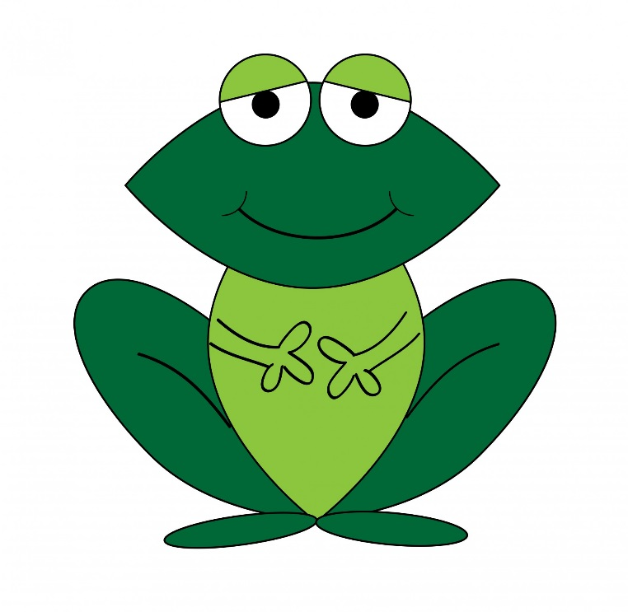
S s
sapo

Slide 34
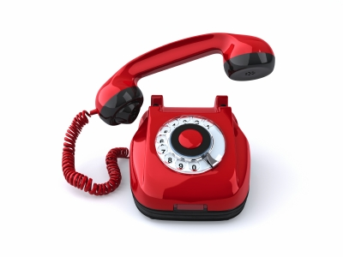
T t
teléfono

Slide 35
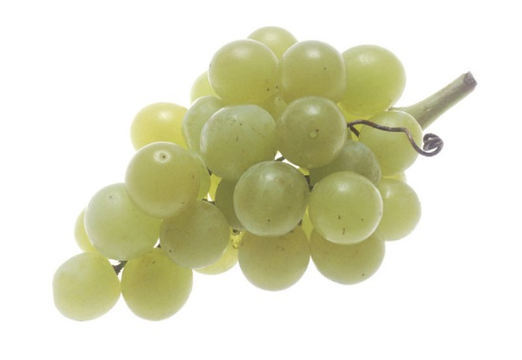
U u
uvas

Slide 36
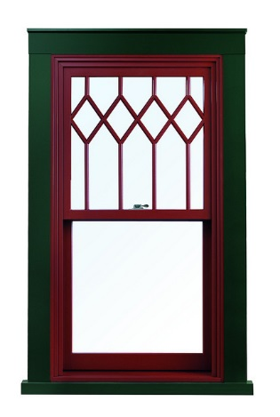
V v
ventana
v is like a soft, breathy ‘b’ sound

Slide 37
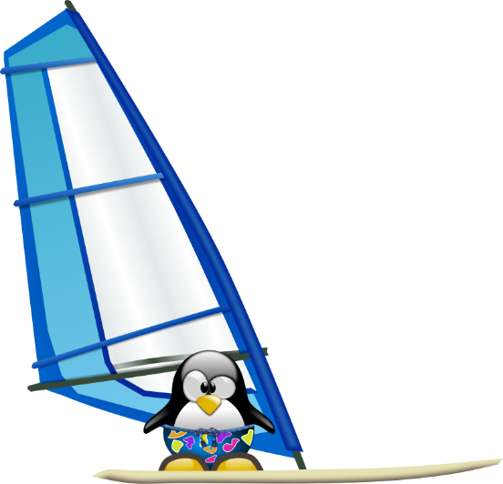
W w
windsurf

Slide 38
X x
xilófono
x at the start of a word is a bit like ‘s’ sound in English

Slide 39
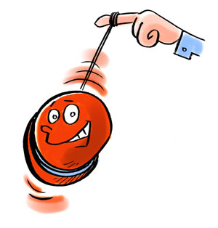
Y y
yoyo

Slide 40
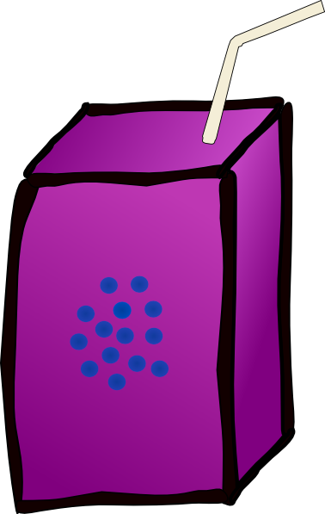
Z z
zumo
z in Spanish sounds like ‘th’ in the English word ‘thin’

Slide 41
Vowels in Spanish are always pronounced the same:
a
= ah
e
= eh
i
= ee
o
= oh
u
= oo

Slide 42
What is a dipthong?
It is two vowels blended together to produce one sound.

Slide 43
Dipthongs (1)
ai/ay
*
= eye
au
= ow
ei/ey
= ay
ie
= yeh
io
= yoh
oi/oy
= oy
*
ua
= wah
*ai, ei and oi are written ay, ey and oy at the end of a word.

Slide 44
Dipthongs (2):
eu
= eh(oo)
ia
= yah
iu
= ee(oo)
ui/uy
*
= oo(ee)
ue
= weh
uo
= oo-oh
ou
= oh-oo
*ui is written uy at the end of a word.

Slide 45
Examples - 1
ai/ay
bailar
io
au
oi/oy
biblioteca
autor
hoy
ua
ei/ey
cuatro
ie
seis
viento

Slide 46
Examples - 2
ou
ia
ue
eu
media
juego
Europa
tour
ui/uy
uo
iu
muy
monstruo
ciudad

Slide 47
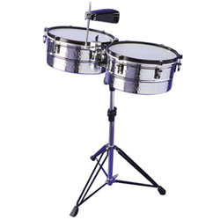
Accents
The accent (/) helps you to pronounce the word.
The accent does not change the vowel sound. It tells you which syllable to pronounce with emphasis.
marrón
batería

Slide 48
Stress
Words that end in a consonant other than n or s should be stressed or said the loudest, on the last syllable.
doctor
Words that end in a vowel, n, or s should be stressed or said the loudest, on the second to last syllable.
libro

Slide 49
Every possible pronunciation of each letter of the Spanish alphabet in ONE sentence! See clip below.

Slide 50
The sentence in Spanish and English
La cigüeña gigante bebió ocho copas de whisky, más quince jarras llenas de fría cerveza rubia, y enseguida huyó en un taxi.
The giant stork drank eight glasses of whiskey, plus fifteen full mugs of cold pale ale, and escaped in a taxi right away.

Slide 51
Fin

