Slide 1
Spanish Sounds 2

Slide 2
Vowels in Spanish are always pronounced the same:
a
= ah
e
= eh
i
= ee
o
= oh
u
= oo

Slide 3
Vowels in Spanish are either weak or strong:
a
e
a, e and o are strong vowels
o
i
i and u are weak vowels
u

Slide 4
What is a diphthong?
When a strong and a weak vowel or two weak vowels combine to form a single syllable, they form what is known as a diphthong.

Slide 5
Diphthongs (1)
ai/ay*
= eye
au
= ow
ei/ey*
= ay
ie
= yeh
io
= yoh
oi/oy*
= oy
ua
= wah
*ai, ei and oi are written ay, ey and oy at the end of a word.

Slide 6
Examples - 1
ai/ay
bailar
io
au
oi/oy
biblioteca
autor
hoy
ua
ei/ey
cuatro
ie
seis
viento

Slide 7
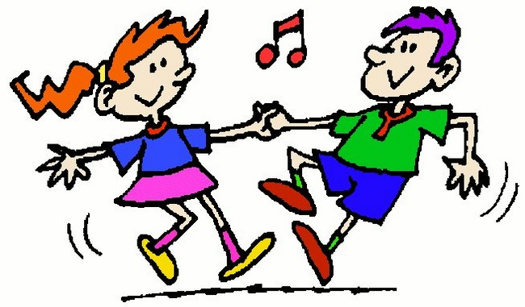
ai/ay
bailar

Slide 8
au
autor

Slide 9
ei/ey
seis

Slide 10
ie
viento

Slide 11
io
biblioteca

Slide 12
oi/oy
hoy

Slide 13
ua
cuatro

Slide 14
Diphthongs (2):
eu
= eh(oo)
ia
= yah
iu
= ee(oo)
ui/uy
*
= oo(ee)
ue
= weh
uo
= oo-oh
ou
= oh-oo
*ui is written uy at the end of a word.

Slide 15
Examples - 2
ou
ia
ue
eu
media
juego
Europa
tour
ui/uy
uo
iu
muy
monstruo
ciudad

Slide 16
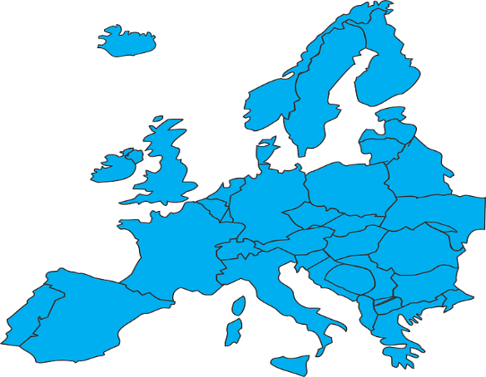
eu
Europa

Slide 17
ia
media

Slide 18
iu
ciudad

Slide 19
ui/uy
muy

Slide 20
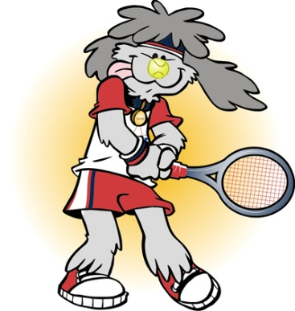
ue
juego

Slide 21
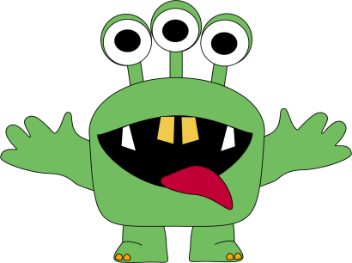
uo
monstruo

Slide 22
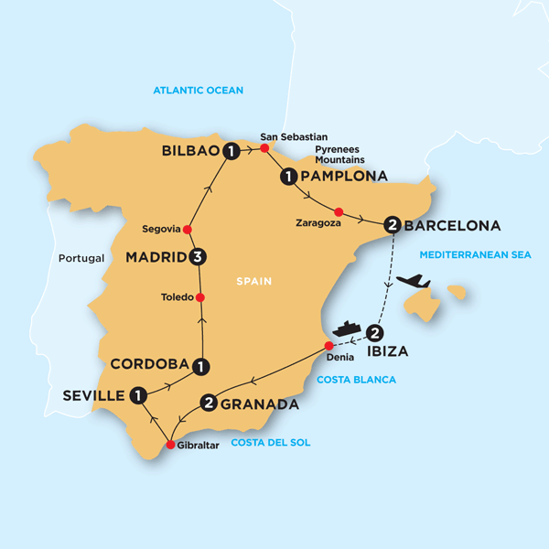
ou
tour

Slide 23
What is a hiatus?
When two strong vowels are together in a word they are pronounced as two distinct syllables, and this is known as a hiatus.

Slide 24
Examples
eo
ae
leo
caer

Slide 25
eo
leo

Slide 26
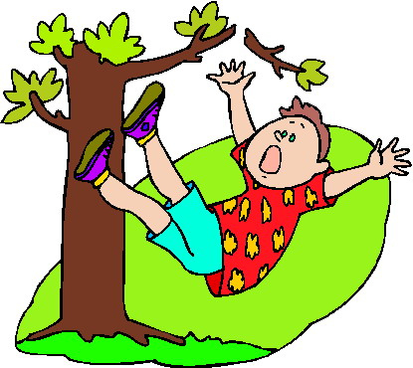
ae
caer

